Slide 1
River Water Quality Monitoring System
Bhasskar
Roshan

Slide 2
Abstract
The degradation of water resources has become a common problem.
The Convention Methods of water quality monitoring I laborious.
IoT makes this easier by enabling remote monitoring of resources and real-time access to data
MQTT protocol ensures simultaneous flow of data between sensors and servers

Slide 3
Problem Statement
In this project we intend to present the design and development of a low cost system for real monitoring of water quality in an IoT environment. The system consists of several sensors which are used for measuring physical and chemical parameters of water.

Slide 4
USP
Working with IBM Watson cloud services
Accessing Sensor data from anywhere in the world.
Notifications and SMS are triggered based on sensor values automatically.
Reduces Manual effort involved in monitoring river water quality.
Constant Visualization of sensor data by the cloud.
It can be used even in remote areas where manual presence is impossible

Slide 5
Requirements
Hardware
NodeMCU
Turbidity Sensor
Temperature Sensor
GSM Module
Software
Arduino IDE

Slide 6
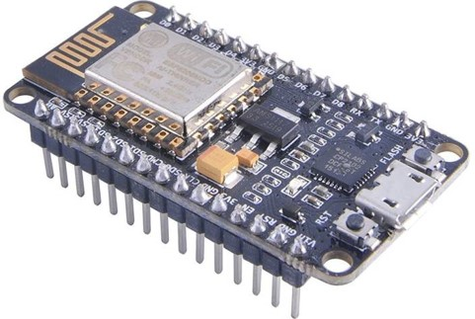
Components Description NodeMCU
NodeMCU is an open source IoT platform. It includes firmware which runs on the ESP8266 Wi-Fi SoC from Espressif Systems, and hardware which is based on the ESP-12 module. The term "NodeMCU" by default refers to the firmware rather than the development kits. The firmware uses the Lua scripting language. It is based on the eLua project, and built on the Espressif Non-OS SDK for ESP8266. It uses many open source projects, such as lua-cjson and SPIFFS.

Slide 7
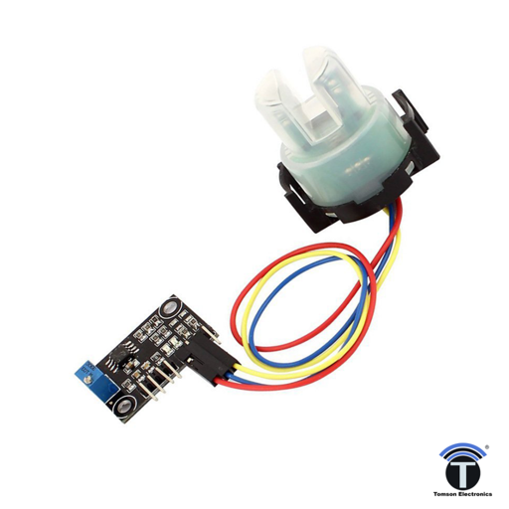
Turbidity Sensor
When viewed from front, the turbidity sensor appears like an Android bot. Two horn like structure, a top to bottom mono material body. A black coloured cap is placed at the bottom of the sensor. Thick alloyed contact legs provide means for various connectors to hold to the sensor. A white plastic slab protects the legs from damage and act as a fixture for good clamping of the sensor. The plastic used to make outer structure can survive high temperature variations as well as mechanical abrasions.

Slide 8
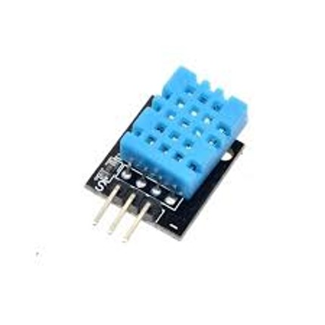
Temperature Sensor
A temperature sensor is exactly what it sounds like – a sensor used to measure ambient temperature. It is a DHT sensor which is integrated with NodeMCU or Arduino Uno R3, and use the Arduino IDE's serial monitor to display the temperature.

Slide 9
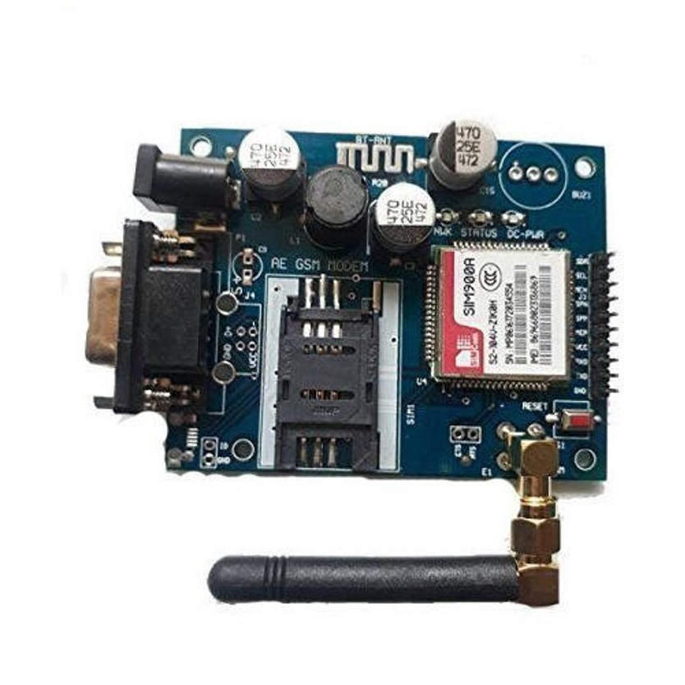
GSM Module
A GSM module is a chip or circuit that will be used to establish communication between a mobile device or a computing machine and a GSM or GPRS system. The modem (modulator-demodulator) is a critical part here. These modules consist of a GSM module or GPRS modem powered by a power supply circuit and communication interfaces (like RS-232, USB 2.0, and others) for computer. A GSM modem can be a dedicated modem device with a serial, USB or Bluetooth connection, or it can be a mobile phone that provides GSM modem capabilities

Slide 10
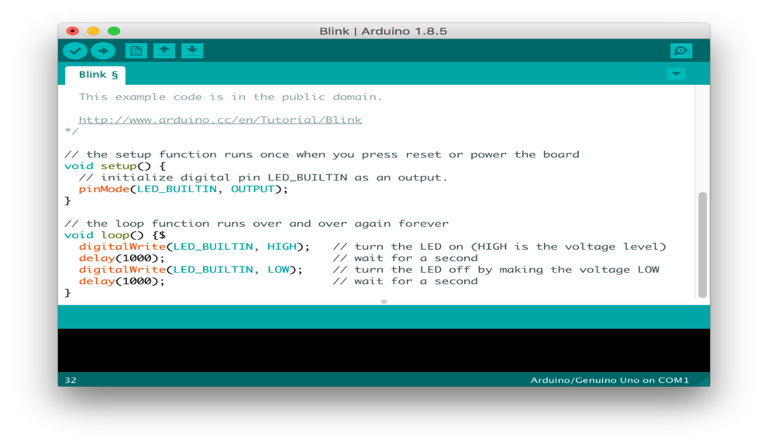
Arduino IDE
The Arduino integrated development environment (IDE) is a cross-platform application (for Windows, macOS, Linux) that is written in the programming language Java. It is used to write and upload programs to Arduino compatible boards, but also, with the help of 3rd party cores, other vendor development boards.

Slide 11
Connections
The connections are made accordingly from NodeMCU to temperature sensor, turbidity sensor, GSM module, basic board.
NodeMCU to basic shield – Connect VCC to 3.3V, ground to ground and DHT 11 pin to D2
NodeMCU to turbidity board – Connect VCC to V(in), ground-ground, A0-A0
GSM module to NodeMCU - Connect ground-ground, Tx- D7, Rx-D8.
Turbidity sensor to its board- The three pins are arranged in a way as of the thermistor output is connected to ground, the photodiode output is connected to TIN and the last of all the phototransistor input is connected to VCC.

Slide 12
Thank You

